Slide 1

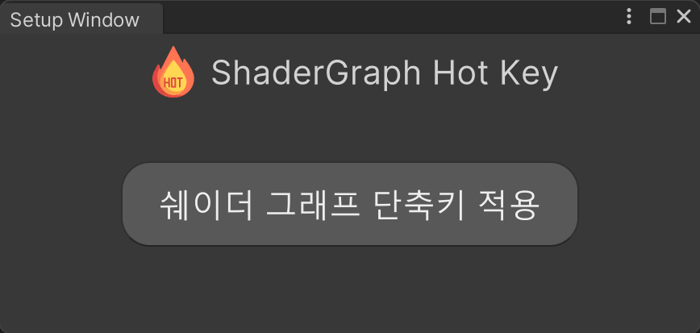
Shader Graph Hot Key
1.2.0 Lite
Amplify Shader Graph has shortcut keys, but Unity Shader Graph is not, so it is a plugin that was created.
How to install :
Prepare the state in which Shader Graph is installed.
At the top of Unity, click Windows -> ShadowGraph Hotkey -> Setup Window, and then click the corresponding button.
Installing :
During installation, Define is added, the function is activated, and 'Shortcut key application is complete' in the Setup Window. The patch is finally completed when the message pops up.

Slide 2
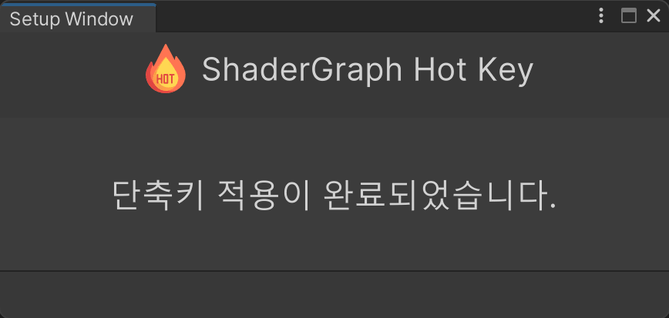
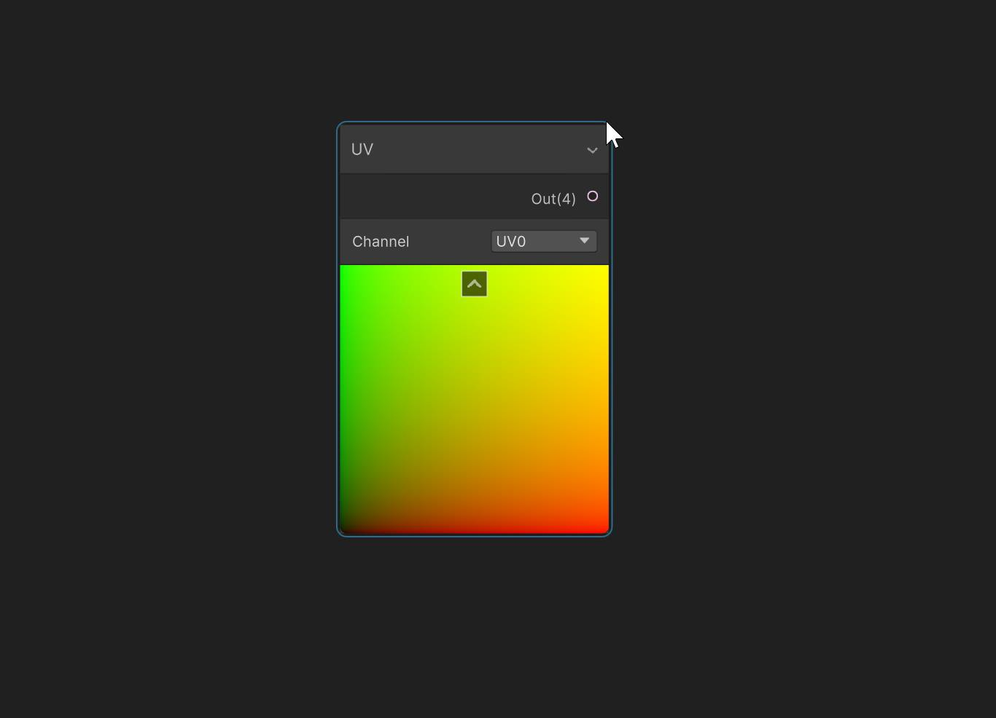
installed!
When the installation is complete, you will see the following message.
사용법 :
Usage is the same as the Amplify shader shortcut system.
The shortcut for UV node is U, and while holding down the U key, If you click the left mouse button, a node will appear at the mouse cursor position.
is created.

Slide 3
Shortcut set
IntegerNode : | alpha 0
Vector1Node : | alpha 1
Vector2Node : | alpha 2
Vector3Node : | alpha 3
Vector4Node : | alpha 4
ColorNode : | alpha 5
SampleTexture2DNode : | T
UVNode : | U
AddNode : | A
SubtractNode : | S
MultiplyNode : | M
DivideNode : | D
OneMinusNode : | O
PowerNode : | E
LerpNode : | L
SplitNode : | B
SwizzleNode : | Z
NormalizeNode : | N
DotProductNode : | . (Dot)

Slide 4
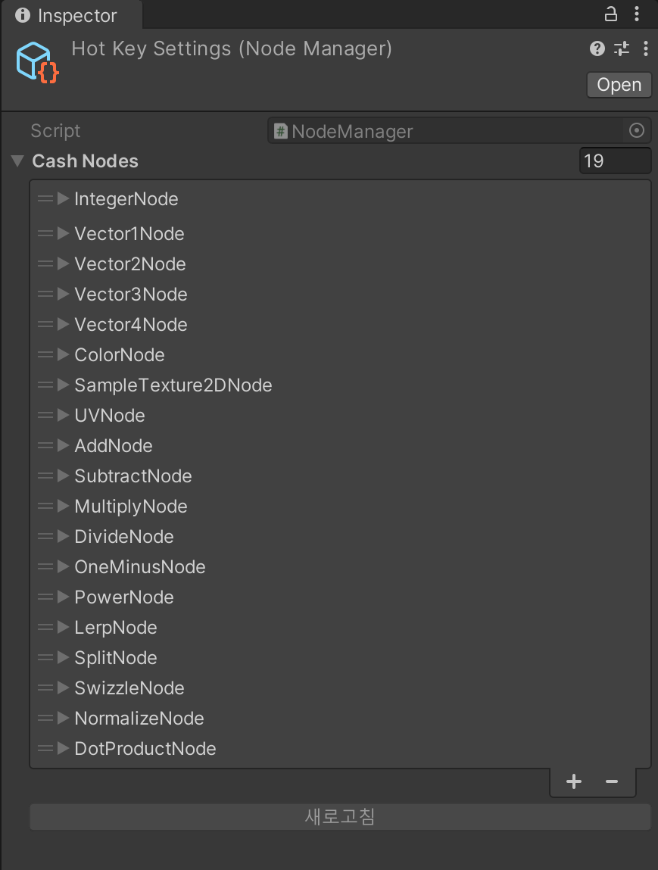
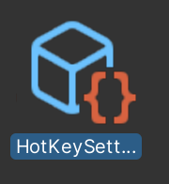

How to add shortcuts
Assets/Plugins/ShaderGraphHotKey/Settings/HotKeySettings.asset
If you go to the following path, you will find the HotKey Settings asset.
Click + to add a list.

Slide 5
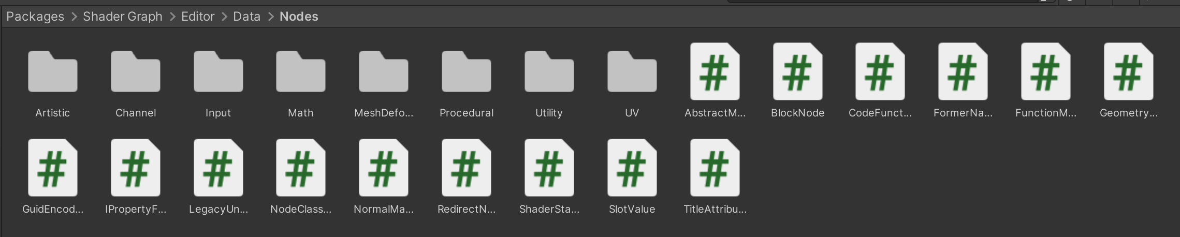
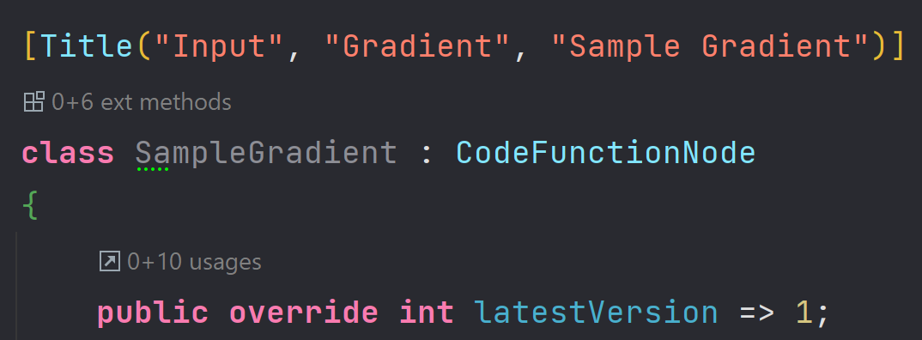

How to add shortcuts
Packages/com.unity.shadergraph/Editor/Data/Nodes
If you move from the package folder to the following path, you can see the nodes used in the shader graph.(It is recommended to use only what is in the folder)
copy
Assuming this node applies to shortcut keys,
copy the node's class name.
TMI : Sometimes, the C# file name and the class name are different, so be careful.

Slide 6
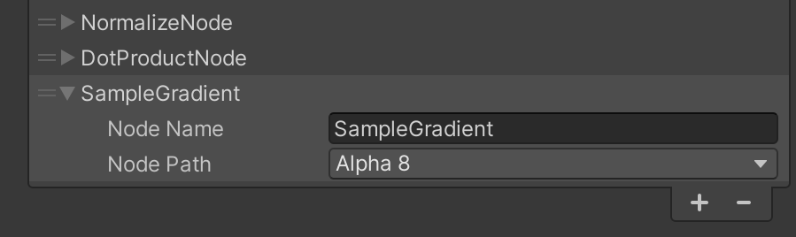
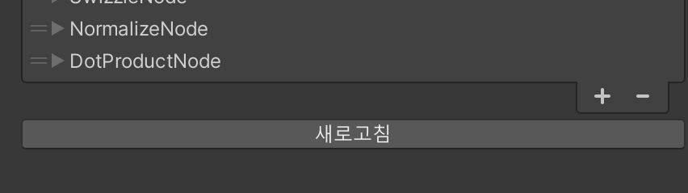
단축키를 추가하는 방법
Write the desired node (class) name in the settings file, and select the desired keystroke.
When the Refresh button becomes active, click it to finalize the application.
Caution!
If key input is duplicated with other nodes, it may not work, so be careful.
END!

